Slide 1
.REACT
Lesson 2: Adding Interactivity

Slide 2
Adding Interactivity
Dealing with Data
Props by listing their names
Dealing with State
Meet your first hook (useState, useEffect)
Events
Setting state triggers a re-render
Controlled Component
Updating Objects
Lifting state up

Slide 3
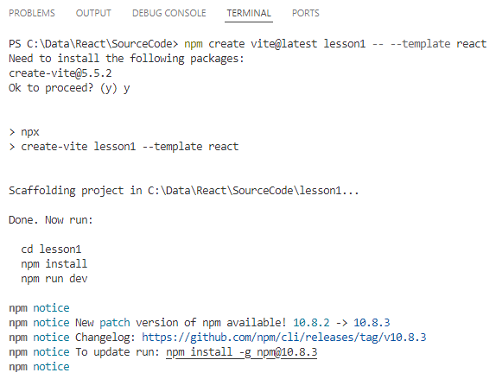
Create
npm create vite@latest lesson2 -- --template react
VSCode
File | Open Folder
lesson2

Slide 4
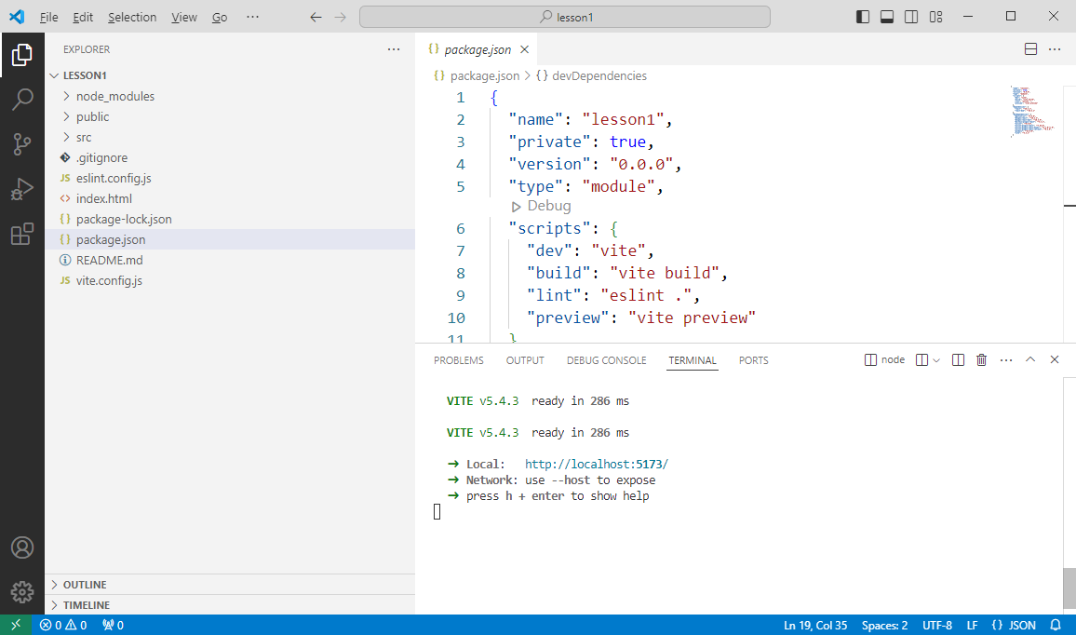
npm install
npm install
npm run dev

Slide 5
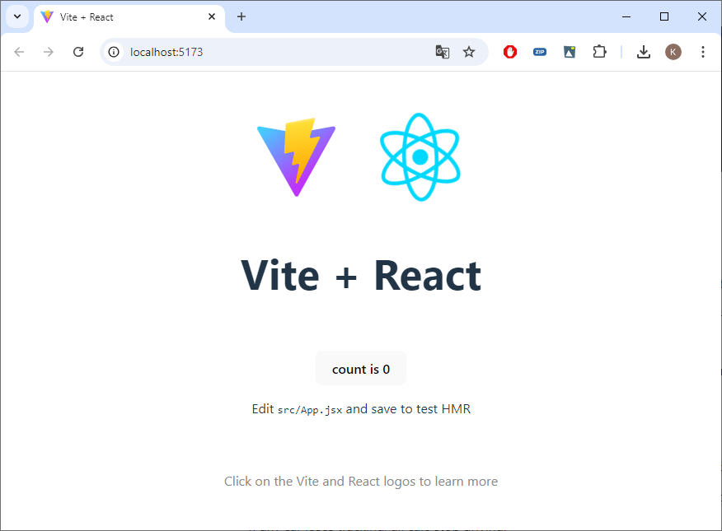
npm run dev

Slide 6
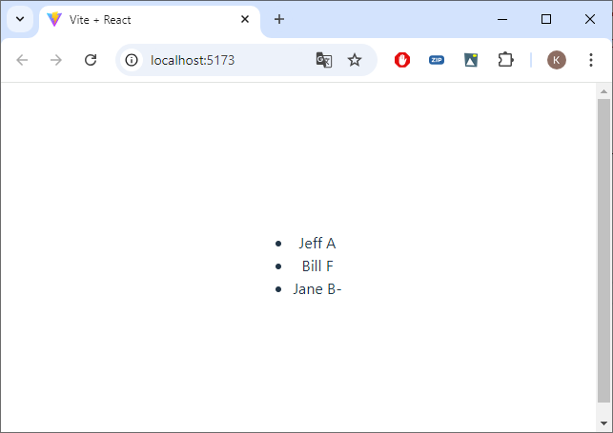
Examples
Copy App.jsx and data.js from Resources to src
Copy components from Resources to src

Slide 7
Dealing with data (data.js & App.jsx)
export const students = [
{ "id" : 1 , "name" : "Jeff", "grade" : "A"} ,
{ "id" : 2 , "name" : "Bill", "grade" : "F"} ,
{ "id" : 3 , "name" : "Jane", "grade" : "B-"} ];
Use { } when importing
functions that are not exported
by default
import './App.css';
import { students } from './data';
import { ListArray } from './components/lists';
function App() {
return (
<div>
<ListArray students={students} />
</div>
);
}
export default App;

Slide 8
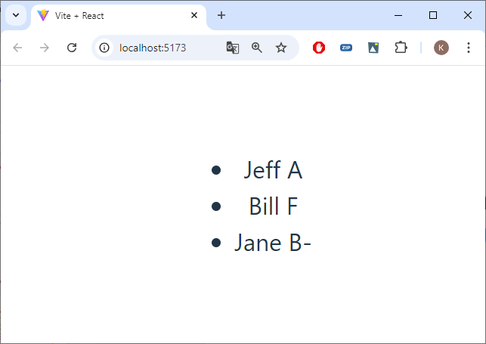
Dealing with data (lists.jsx)
export function ListArray(props) {
let listItems = [];
for (var i = 0; i < props.students.length; i++) {
listItems.push(<li>{props.students[i].name} {props.students[i].grade}</li>);
}
return (
<ul>
{listItems}
</ul>
);
}

Slide 9
props by listing their names
Don't forget { }
More then one property: { name, address, ... }
export function ListArray({ students }) {
let listItems = [];
for (var i = 0; i < students.length; i++) {
listItems.push(<li>{students[i].name} {students[i].grade}</li>);
}
return (
<ul>
{listItems}
</ul>
);
}

Slide 10
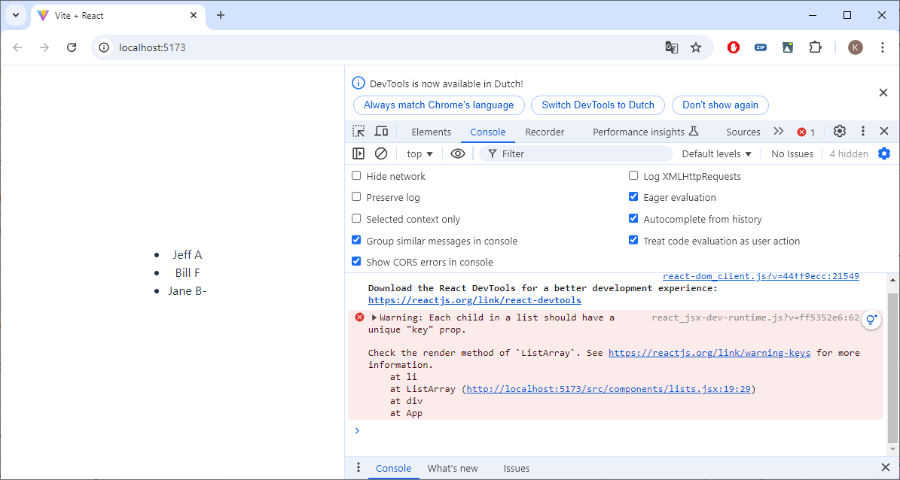
Arrays
export function ListArray({ students }) {
let listItems = [];
for (var i = 0; i < students.length; i++) {
listItems.push(<li>{students[i].name} {students[i].grade}</li>);
}
return (
<ul>
{listItems}
</ul>
);
}

Slide 11
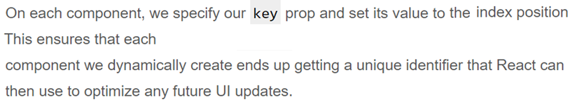
Key property
export function ListArray({ students }) {
let listItems = [];
for (var i = 0; i < students.length; i++) {
listItems.push(<li key={students[i].id}>{students[i].name} {students[i].grade}</li>);
}
return (
<ul>
{listItems}
</ul>
);
}

Slide 12
Map-iterator (App.jsx)
import './App.css';
import { students } from './data';
import { ListMap } from './components/lists';
function App() {
return (
<div>
<ListMap students={students} />
</div>
);
}
export default App;

Slide 13
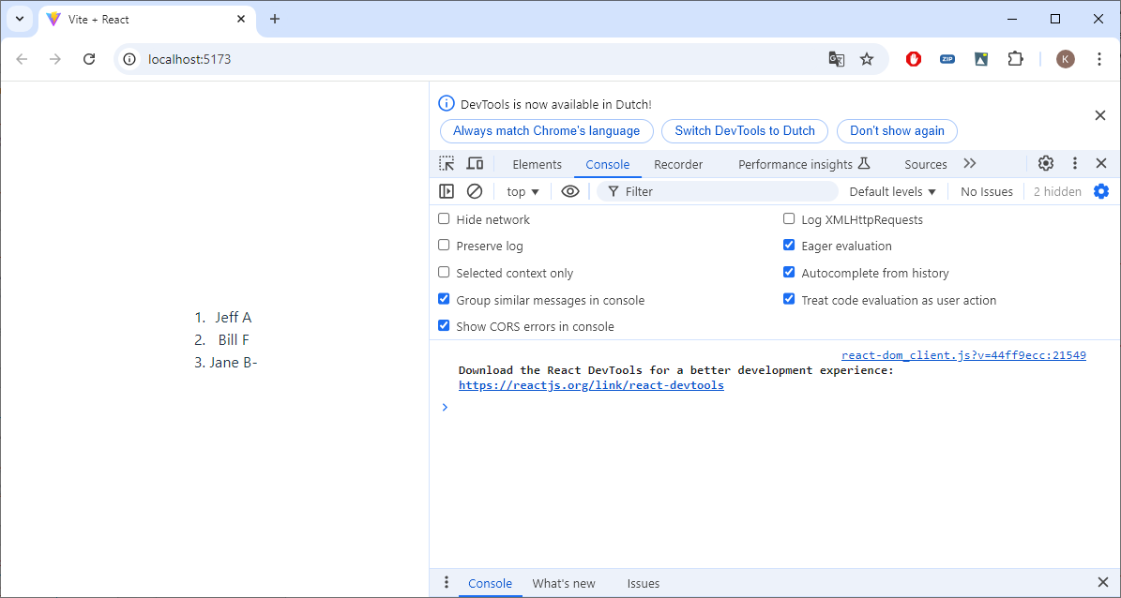
Map-iterator (lists.jsx)
export function ListMap({ students }) {
const listItems = students.map(student =>
<li key={student.id}>{student.name} {student.grade}</li>
);
return (
<ol>
{listItems}
</ol>
);
}

Slide 14
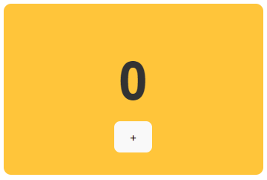
Dealing with state (App.jsx)
import './App.css';
import { students } from './data';
import { ListMap } from './components/lists';
import Counter from './components/counter';
function App() {
return (
<div>
<Counter />
<br />
<ListMap students={students} />
</div>
);
}
export default App;
Properties are read-only
Can we use local variables?

Slide 15
Counter (counter.jsx)
function Number({ display }) {
var textStyle = {
fontSize: 72,
fontFamily: "sans-serif",
color: "#333",
fontWeight: "bold"
};
return (
<div style={textStyle}>
{display}
</div>
);
}
function Counter() {
let count = 0;
function handleClick() {
count = count + 1;
}
return (
<div style={backgroundStyle}>
<Number display={count}/>
<button>+</button>
</div>
);
}

Slide 16
Dealing with state
Can we use local variables?
Changes to local variables don’t trigger renders
Local variables don’t persist between renders
return (
<div style={backgroundStyle}>
<Number display={count}/>
<button onClick={handleClick}>+</button>
</div>
);

Slide 17
Meet your first Hook
The useState Hook returns a pair:
const [count, setCount] = useState(0);
A state variable to retain the data between renders
A state setter function trigger React to re-render the component again and make the new state active.
Don't mutate state (count = count + 1)!
The only argument to useState is the initial state

Slide 18
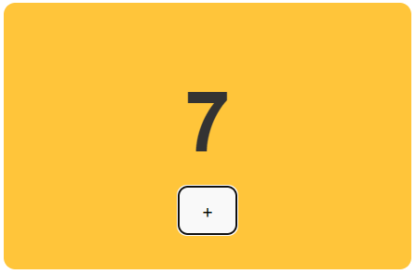
Counter (counter.jsx)
import { useState } from 'react';
function Number({ display }) {
...
}
function Counter() {
const [count, setCount] = useState(0);
...
function handleClick() {
setCount(count + 1);
}
return (
<div style={backgroundStyle}>
<Number display={count}/>
<button onClick={handleClick}>+</button>
</div>
);
}
export default Counter;

Slide 19
Hooks (more to come later)
Hooks are functions that let you hook into React state and lifecycle features from function components
The useState Hook lets you add React state to function components
The useEffect Hook lets you perform side effects in function components (you can tell React that your component needs to do something after render)

Slide 20
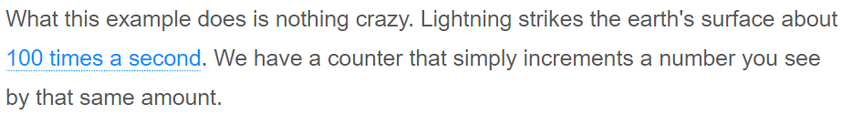
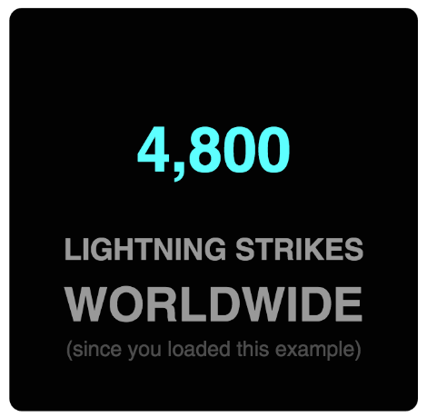
UseEffect hook

Slide 21
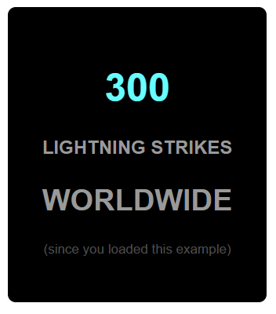
LightningCounter (App.jsx)
import './App.css';
import { students } from './data';
import { ListMap } from './components/lists';
import Counter from './components/counter';
import LightningCounter from './components/lightning_counter';
function App() {
return (
<div>
<LightningCounter />
<br />
<Counter />
<br />
<ListMap students={students} />
</div>
);
}
export default App;

Slide 22
lightning_counter.jsx
function Label({ number }) {
... return (
<h1 style={labelStyle}>{number}</h1>
);
}
function LightningCounter() {
... return (
<div style={divStyle}>
<Label number={300}/>
<h2>LIGHTNING STRIKES</h2>
<h2 style={textStyles.emphasis}>WORLDWIDE</h2>
<p style={textStyles.small}>(since you loaded this example)</p>
</div>
);
}

Slide 23
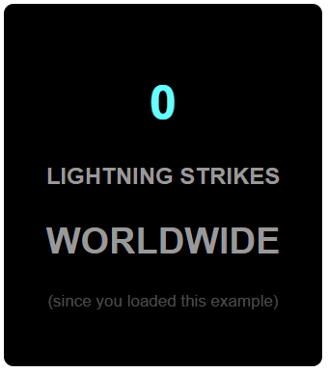
Setting the Initial State Value
import { useState } from 'react';
... function LightningCounter() {
const [count, setCount] = useState(0);
...
function add100Strikes() {
setCount(count + 100);
}
return (
<div style={divStyle}>
<Label number={count}/>
<h2>LIGHTNING STRIKES</h2>
<h2 style={textStyles.emphasis}>WORLDWIDE</h2>
<p style={textStyles.small}>(since you loaded this example)</p>
</div>
);
}

Slide 24
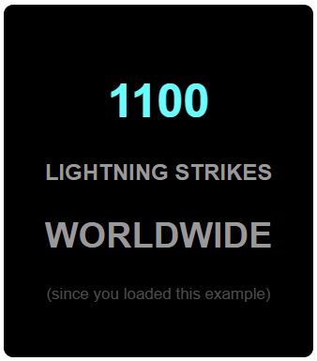
Starting Our Timer
import { useState, useEffect } from 'react';
...
function LightningCounter() {
...
function add100Strikes() {
setCount(count + 100);
}
useEffect(() => {
const interval = setInterval(add100Strikes, 1000);
});
...

Slide 25
useEffect (we'll discuss useEffect in detail later)
With the useEffect Hook, we tell React to start a timer after the component is rendered (mounted)
We'll add 100 lightning strikes every second
But changing the count state will force React to render the component again and as a consequence starting a new timer when rendered
We would get dozens of setIntervals running
With the clearInterval() method, we stop the previous timer, when the components gets unmounted
useEffect(() => {
const interval = setInterval(add100Strikes, 1000);
return () => clearInterval(interval);
});

Slide 26
Back to our counter
How to add 10 when when simultaneously pressing shift?
function handleClick(event) {
if (event.shiftKey) {
setCount(count + 10);
} else {
setCount(count + 1);
}
}

Slide 27
Listen to Events on Components
function PlusButton() {
return (
<button>
+
</button>
);
}
return (
<div style={backgroundStyle}>
<Number display={count}/>
<PlusButton onClick={handleClick} />
</div>
);

Slide 28
Listen to Events on Components
function PlusButton({ onClick }) {
return (
<button onClick={onClick}>
+
</button>
);
}
return (
<div style={backgroundStyle}>
<Number display={count}/>
<PlusButton onClick={handleClick} />
</div>
);

Slide 29
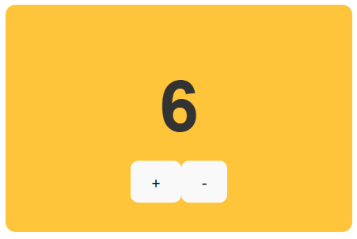
Listen to Events with parameters
function Button({ operation, onClick }) {
return (
<button onClick={onClick}>
{operation}
</button>
);
}
return (
<div style={backgroundStyle}>
<Number display={count}/>
<Button operation="+" onClick={handleClick} />
<Button operation="-" onClick={handleClick} />
</div>
);

Slide 30
Listen to Events with parameters
return (
<div style={backgroundStyle}>
<Number display={count}/>
<Button operation="+" onClick={handleClick} />
<Button operation="-" onClick={handleClick} />
</div>
);
function Button({ operation, onClick }) {
return (
<button onClick={(event) => onClick(event, operation)}>
{operation}
</button>
);
}
Exercise: make the counter work again

Slide 31
Quiz (count_to_three.js)
import { useState } from 'react';
export default function Plus3Counter() {
const [number, setNumber] = useState(0);
function handleClick() {
setNumber(number + 1);
setNumber(number + 1);
setNumber(number + 1);
}
return (
<>
{number}
<button onClick={handleClick}>+3</button>
</>
)
}

Slide 32
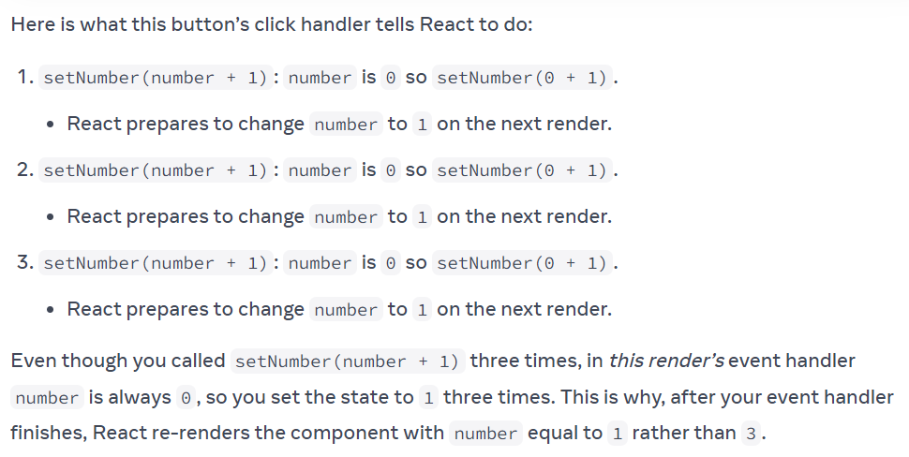
Setting state triggers a re-render

Slide 33
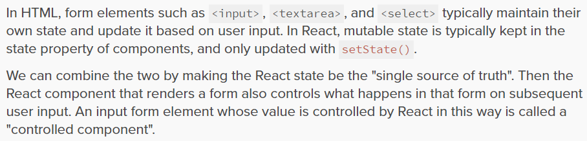

Controlled Component

Slide 34
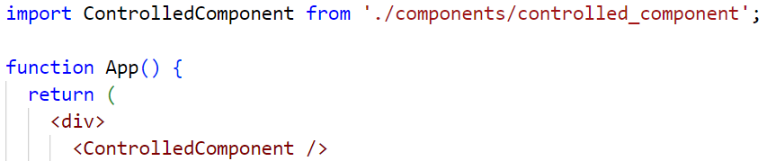
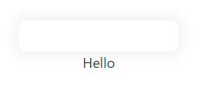
Controlled Component

Slide 35
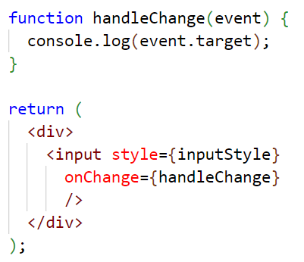
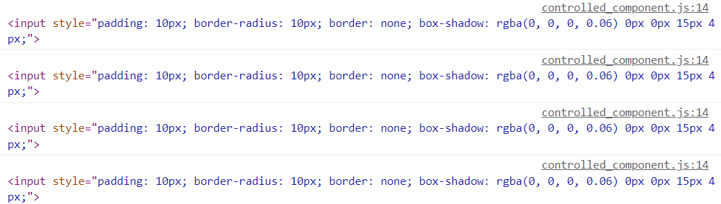
Event.target - Controlled Component

Slide 36
Making React the single source of truth
import { useState } from 'react';
function ControlledComponent(){
... const [firstname, setFirstname] = useState('');
function handleChange(event) {
setFirstname(event.target.value);
}
return (
<div>
<input style={inputStyle}
onChange={handleChange}
value={firstname}
/>
<div>Hello {firstname}</div>
...

Slide 37
Updating Objects in State (form.jsx)
return (
<>
...<input
value={person.firstName}
onChange={handleFirstNameChange}
/>
...<input
value={person.lastName}
onChange={handleLastNameChange}
/>
</div>
...<input
value={person.email}
onChange={handleEmailChange}
/>
</div>
<p>
{person.firstName}{' '}
{person.lastName}{' '}
({person.email})
</p>
</>
);
}
import { useState } from 'react';
export default function Form() {
const [person, setPerson] = useState({
firstName: 'Jeff',
lastName: 'Jones',
email: 'jjones@thomasmore.be'
});
function handleFirstNameChange(e) {
person.firstName = e.target.value;
}
function handleLastNameChange(e) {
person.lastName = e.target.value;
}
function handleEmailChange(e) {
person.email = e.target.value;
}

Slide 38
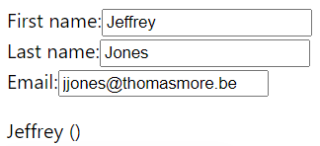
Updating Objects in State
export default function Form() {
const [person, setPerson] = useState({
firstName: 'Jeff',
lastName: 'Jones',
email: 'jjones@thomasmore.be'
});
function handleFirstNameChange(e) {
setPerson({ firstName: e.target.value });
}
function handleLastNameChange(e) {
setPerson({ lastName: e.target.value });
}
function handleEmailChange(e) {
setPerson({ email: e.target.value });
}

Slide 39
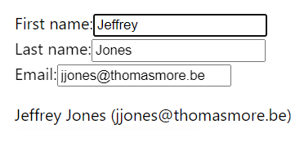
Use the ... object spread syntax
function handleFirstNameChange(e) {
setPerson({
firstName: e.target.value, // first name from input
lastName: person.lastName, // others from person
email: person.email
});
}
function handleLastNameChange(e) {
setPerson({
...person, // copy old fields of person
lastName: e.target.value // override this one
});
}
function handleEmailChange(e) {
setPerson({
...person, // copy old fields of person
email: e.target.value // override this one
});
}

Slide 40


Exercise: accordion.jsx
export default function Accordion() {
return (
<>
<h2>Almaty, Kazakhstan</h2>
<Panel title="About">
With a population of about 2 ...
</Panel>
<Panel title="Etymology">
The name comes ...
</>
);
}
function Panel({ title, children }) {
const [isActive, setIsActive] = useState(false);
return (
<section className="panel">
<h3>{title}</h3>
{isActive ? (
<p>{children}</p>
) : (
<button onClick={() => setIsActive(true)}>
Show
</button>
)}
</section>
);
}

Slide 41

Lifting state up
What if we want to change it so that only one panel is expanded at any given time?
To do this, remove state from both of them
Move it to their closest common parent (use an int, no boolean)
Then pass it down to them via props
This is known as lifting state up, and
it’s one of the most common things
you will do writing React code

Slide 42
Exercises
Lifting state up
Calculator
BMI calculator

